Slide 1

STATUS OF CEN TC442 / WG4 / TG3 Semantic Modelling and Linking (SML) standard
W3C LBD meeting | Michel Böhms

Slide 2
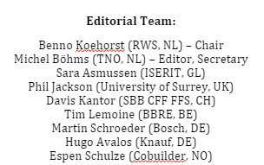
CEN TC442 / WG4 / TG3
TC442 “BIM”
WG4 “Dictionaries”
NOTE: beyond, terms/definitions: actually Data/Information Models or in LD-speak: “Ontologies” (compare bSI bSDD)

Slide 3
Why
There are major social challenges in our built environment
Housing shortage, outdated infrastructures, energy transition, need for circularity, …
The right digitalization in project and asset management can help the solution of these challenges
through an efficient/effective and future-proof data and software landscape
In turn, SML can contribute to
delivering such a future-proof data landscape
as a guideline for uniform semantic modeling of assets (incl. products as ‘assets-you-can-buy’) in the built environment

Slide 4
scope
For all types of assets in the entire built environment
Buildings, roads, railway tracks, bridges, tunnels, dikes, maritime constructions, but also:
Areas such as public spaces with greenery such as parks and trees
Their aggregates and parts
For the entire asset life cycles and supply chains of these assets
Programming, Design, Execution and Management & Use
Client, contractor, subcontractor, supplier, manufacturer
For the entire information lifecycle
Acquisition/creation, storage, transformation, derivation, integration, decision support/making

Slide 5
Key use case types
Data Exchange (data transfer)
Not ideal: multiple copies potentially out of sync
Ok in case of ‘change of ownership’ (think supply chain)
Data Sharing
Ideal: one copy
Best when ‘no change of ownership’ (think life cycle)
Often LD/SW still used for data exchange
Data collection in ‘centralized’ repositories
Future: more distributed
Federated queries (read)
Federated queries (write)
Think SOLID/PODS (read-write web), more secure

Slide 6
Disclaimer (wrt distributed data sharing)
“In general though, relying on external namespaces is unreliable and is one of the weak spots of the semantic technology stack that just didn't work as well in practice as hoped by its designers. Quite often, publishers of vocabularies don't set up the right content negotation policies or implementations don't ask for the right files to download. …
Better download local copies as it also supports offline work and will be faster.”
Holger Knublaug, TopQuadrant
September 2022

Slide 7
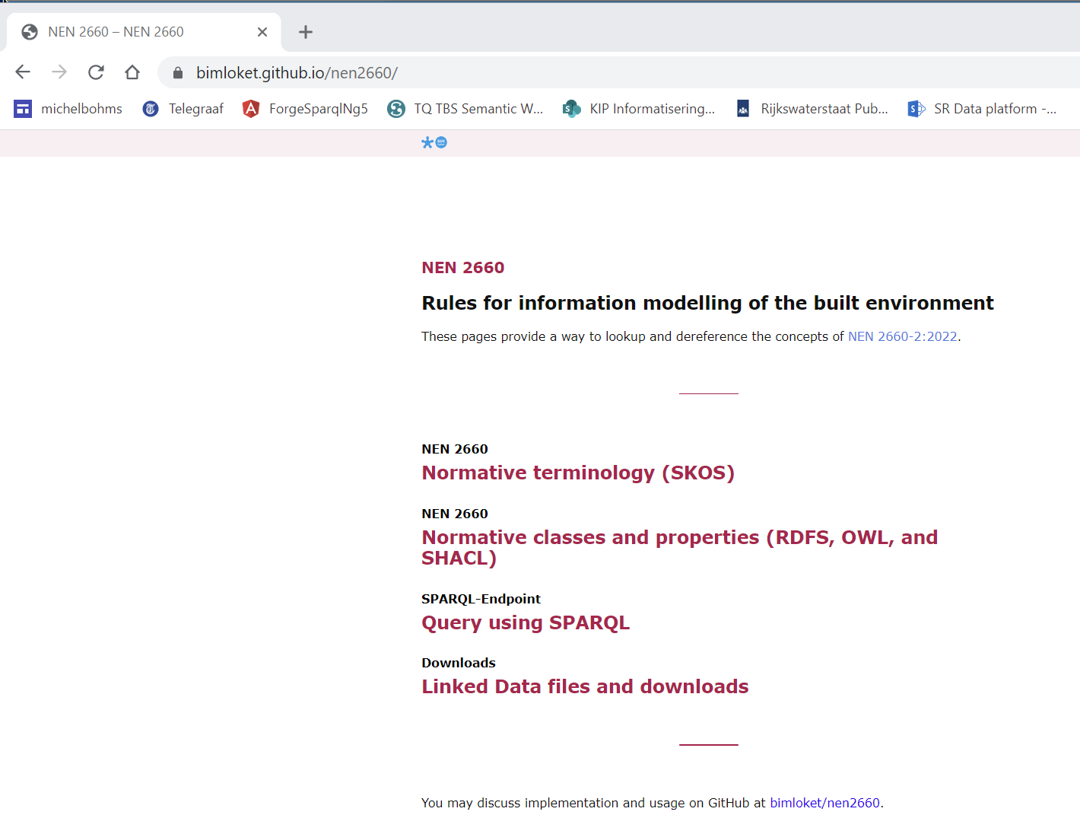
Partly agree but indeed non-trivial
Example NEN-2660-2
By CROW/BIM Loket
(quite new for NEN/CEN/ISO)
In future also for SML

Slide 8

guiding principle
FAIRness (gofair.org)
Findable, typically in de cloud
Accessible, securely accessible via the right identification, authentication & autorisation
Interoperable via application of (sets of) open standards
Reusable, well-defined semantics via information models (like ontologies), that are FAIR themselves!
+ Right data quality depending on context
Relevant, correct, timely, complete, consistent, precise …

Slide 9
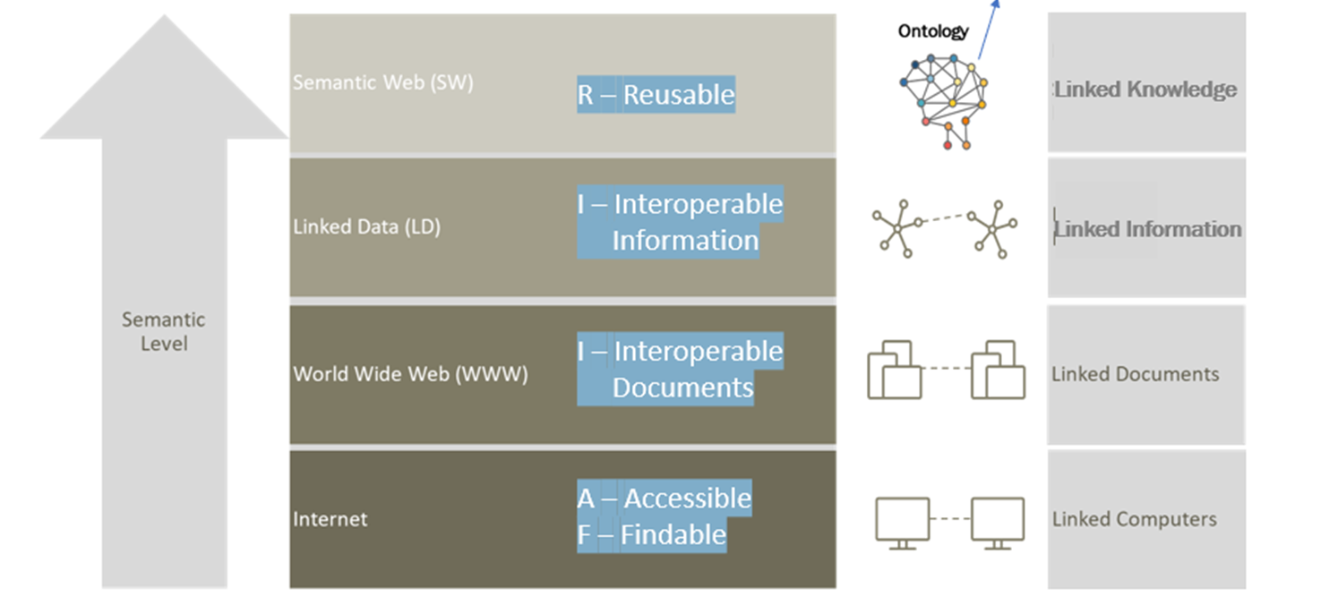
FAIRness powered by Linked data/semantic web

Slide 10
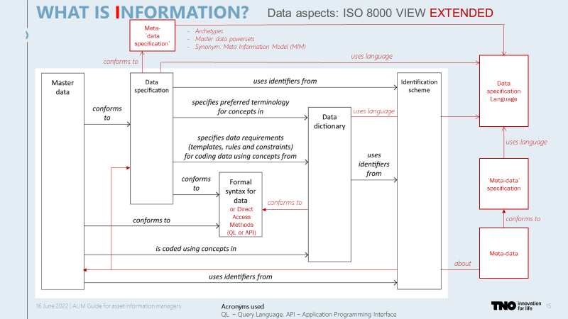
Data? What data?
Data

Slide 11
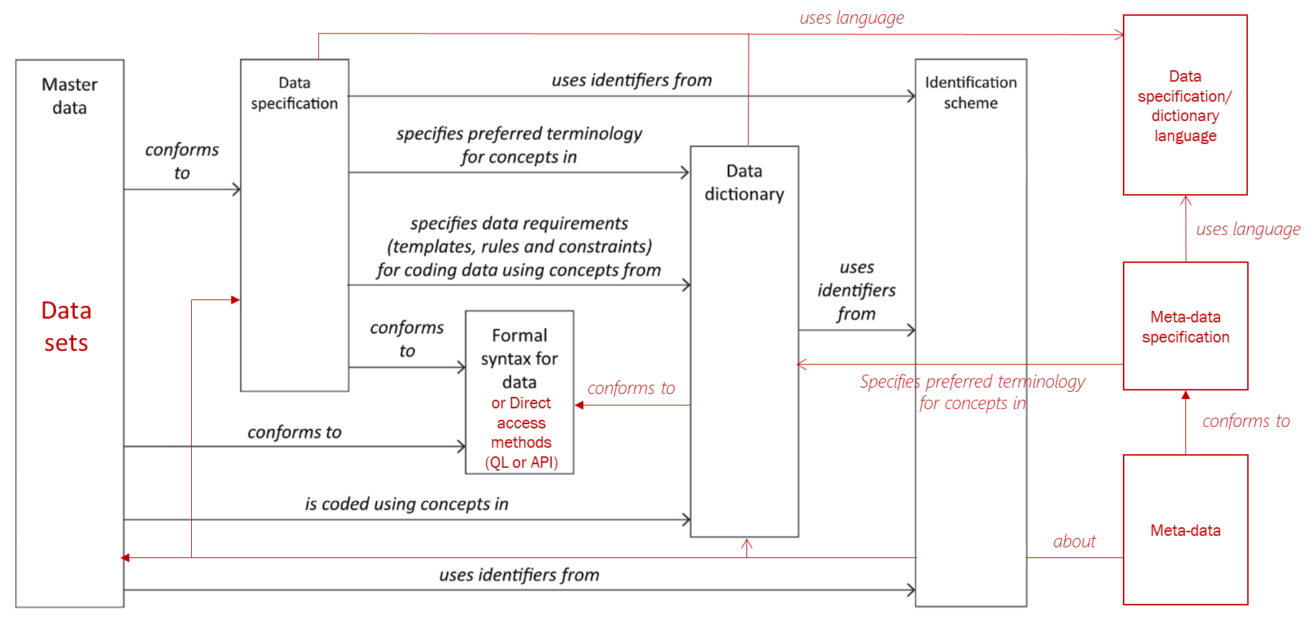
A bit simpler, no MIM

Slide 12
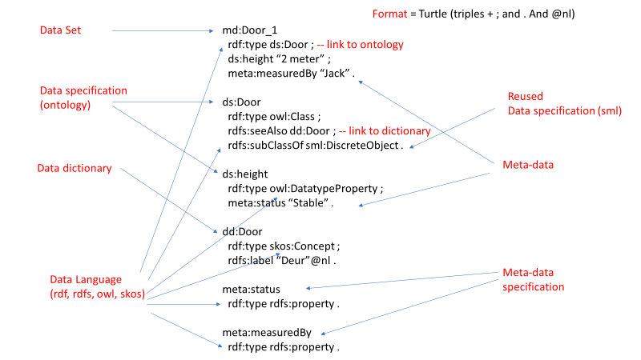
The bigger picture

Slide 13
SML offering
Technology choices: data formats, direct access methods and modeling languages
Here: W3C Linked Data / Semantic Web technology: Turtle/JSON-LD, SPARQL, RDF/RDFS/OWL/SHACL
A generic top-level information model
Objects, Activities, States, Events and their interrelationships
Generic & domain-specific modelling patterns

Slide 14

SML offering
M2: Meta-’information model’
L1:
information
language
optional
L2:
Meta-
‘information
language’
of type
of type
Top level information model
M1: Information model
of type
of type
Information linking
of type
M0: Information set
of type
of type
optional
: “some element in”

Slide 15
Capabilities
LoC-3
Advanced ontology
Strong
semantic
modelling
OWL or
SHACL
Data
integration
LoC-2
Basic ontology
RDFS only
Data exchange
or sharing
LoC-1
Vocabulary/dictionary/
thesaurus
Weak
semantic
modelling
Alignment of terms & definitions
RDF + SKOS

Slide 16
toplevel
hasInterior
Spatial
Entity
Concrete
Concept
hasPart
hasBoundary
Activity
hasState
triggers
hasTemporalEntity
Temporal
Entity
State
begins
Event
ends
hasPart
hasPart
transforms
executes
transforms
hasState
triggers
triggers
Top
Concept
Information
Object
Physical
Object
hasState
isDescribedBy
hasPart (via Object)
hasPart (via Object)

Slide 17
Modelling patterns
Identification, naming and annotation
Specialization (“taxonomy”)
Decomposition and grouping
Materialization (concrete, steel, wood, asphalt)
Quantities, units and quantity kinds & Qualities
Spatial areas versus real objects
Planned things versus realized things
Things versus roles of things (space versus kitchen), aka functional versus technical
Interactions between things (forces, information and material exchanges)
Unstructured requirements

Slide 18
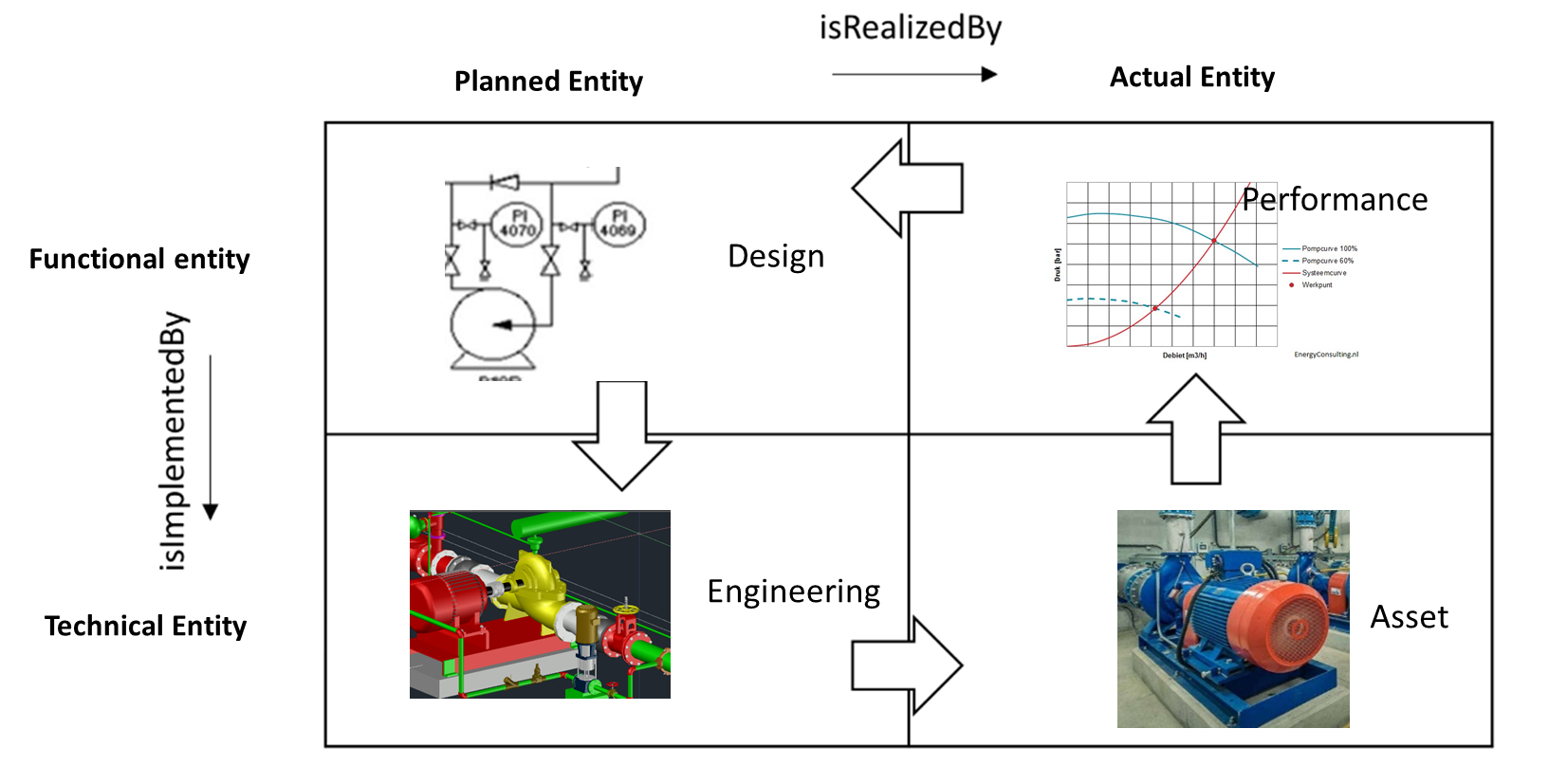
Enabling Systems engineering

Slide 19
Property modelling
Simple (~OPM L1)
No objectification
Unit/Quantity kinds implicit, in name or in datatype
Complex (~OPM L2: subject/object)
Complex value: QuantityKind (QualityKind/RelationReference)
Complicated (~OPM L3)
Objectified predicate and value
W3C SOSA including extended QUDT usage
qudt:QuantityValue
qudt:value, qudt:numericValue
qudt:unit, qudt:hasQuantityKind

Slide 20
Example complex quantity (L2: 2 steps from S to O)
owl:Object
Property
rdf:type
quantity
Kind:
Length
qudt:hasQuantityKind
ex:height
sml/qudt:
Quantity
Value
sml:hasQuantityKind
rdfs:range
ex:Door
Implicit
in RDF
rdf:type
(drived)
unit:M
rdf:type
ex:Door_1
_:height1
sml:hasUnit
ex:height
qudt:unit
qudt:numericValue
rdf:value
“2.4”
^^xsd:double
S
1
2
O

Slide 21
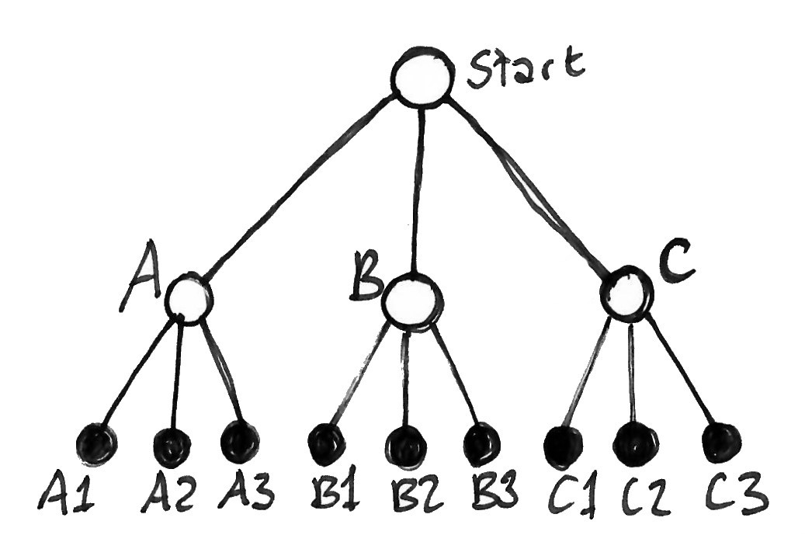
application
Technology, Top Level &
Modelling patterns
SML Top level-model
①
②
PhysicalObject • Entity • Entity
SpatialArea • FunctionalEntity • PlannedEntity
RealObject • TechnicalEntity • RealizedEntity
③
isSubtypeOf
isSubtypeOf
Carriageway
SML compliant
Ontology
isOfType
isOfType
SML compliant
Information Set (“data source”)
Carriageway_122

Slide 22
Related
ISO 21597 Information Container for Data Delivery (ICDD)
buildingSmart IFC/bSDD (in STEP/XML/LD/JSON)
W3C LBD BOT (Building Topology Ontology)
CEN TC442 Data Templates (“86/87”), ISO 12006-3
Industry application (NL)
RWS OTL
Amsterdam OTL
OTL-Gelderland
Waternet OTL (W-OTL)
IMBOR-LD 2022 (urban public)
GWSW (urban Water)
GWSL (urban Light)
TenneT OTL (high voltage power supply)
CB-NL (NL generic ontology below SML top-level), …..need?
PIM: Pavement Information Model (Boskalis, BAM Infra, Heijmans , Van Gelder, Dura Vermeer, KWS)

Slide 23
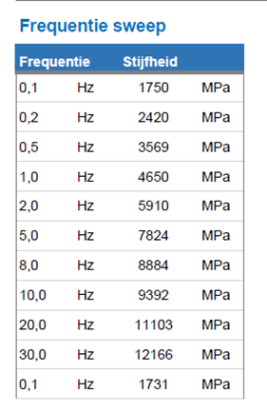
PIM example
:ART00408
a :AsfaltMengsel ;
:frequentieSweep _:QuantityValue_fs .
_:QuantityValue_fs
:frequentieSweepElement _:QuantityValue_1 ;
:frequentieSweepElement _:QuantityValue_2 ;
… .
_:QuantityValue_1
a sml:QuantityValue ;
:checkdata true ;
:frequentie _:QuantityValue_1a ;
:stijfheid _:QuantityValue_1b ;
.
_:QuantityValue_1a
a sml:QuantityValue ;
rdf:value 0.1 ;
sml:hasUnit unit:HZ ;
.
_:QuantityValue_1b
a sml:QuantityValue ;
rdf:value 1750 ;
sml:hasUnit unit:MegaPA ;
.

Slide 24
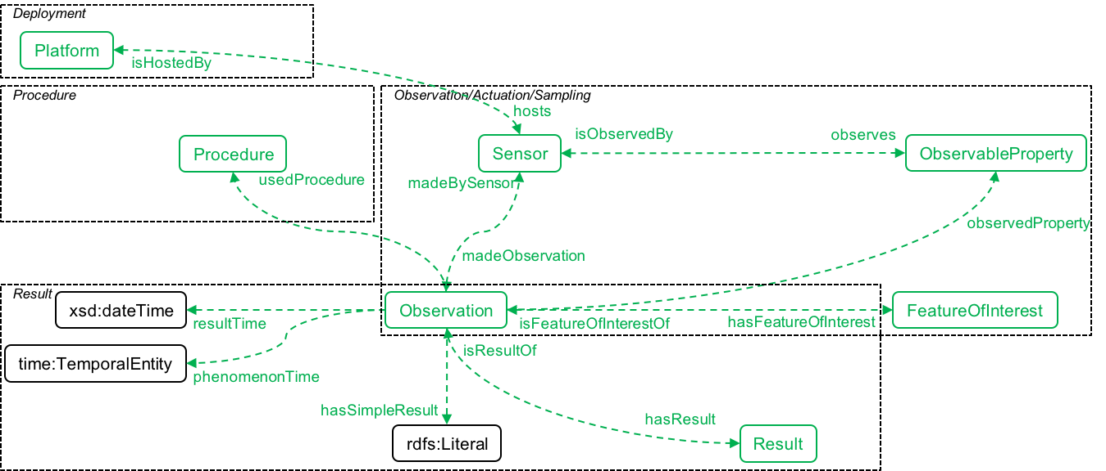
PIM example

Slide 25
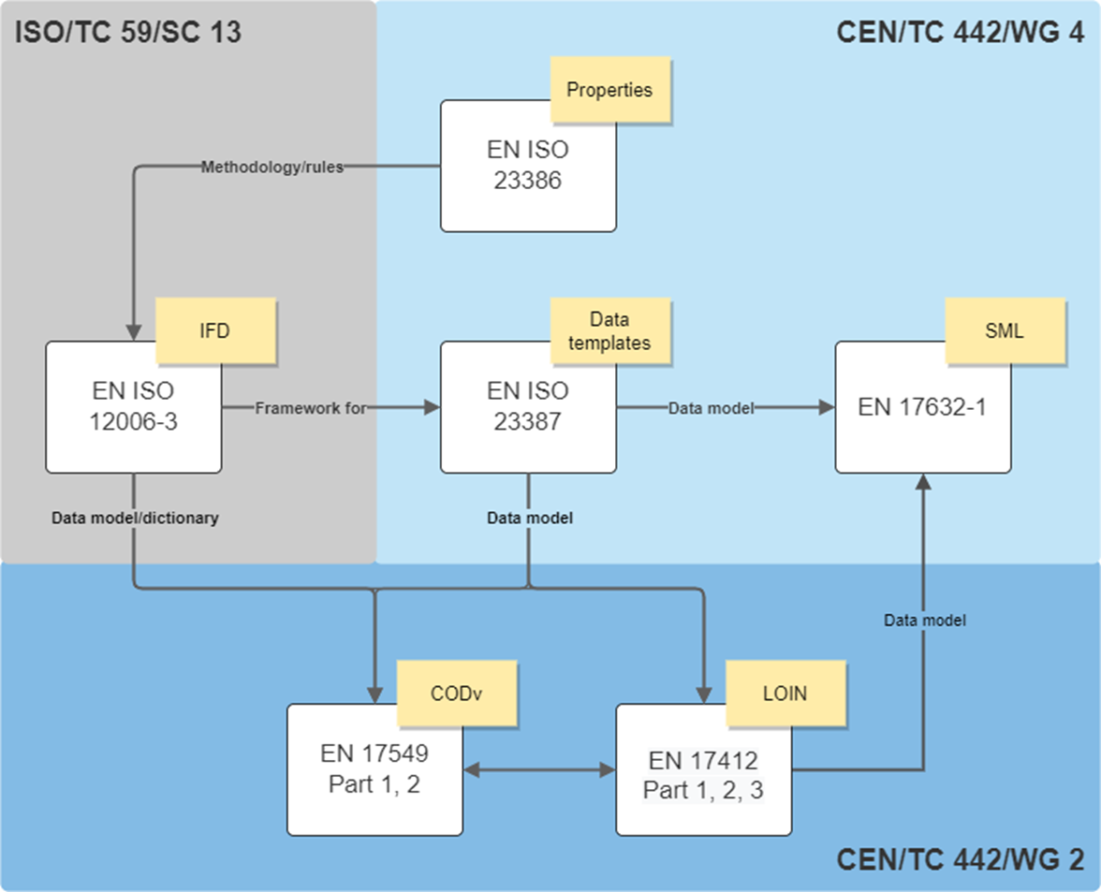
The bigger picture
ISO TC59/SC13 & TC442

Slide 26
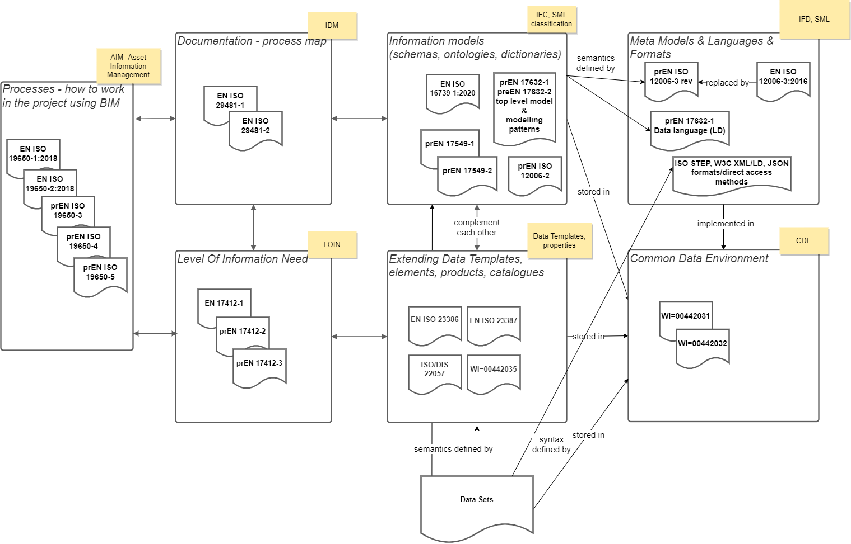
Proposed Update No. 1, under discussion in WG4-WG7
SML

Slide 27
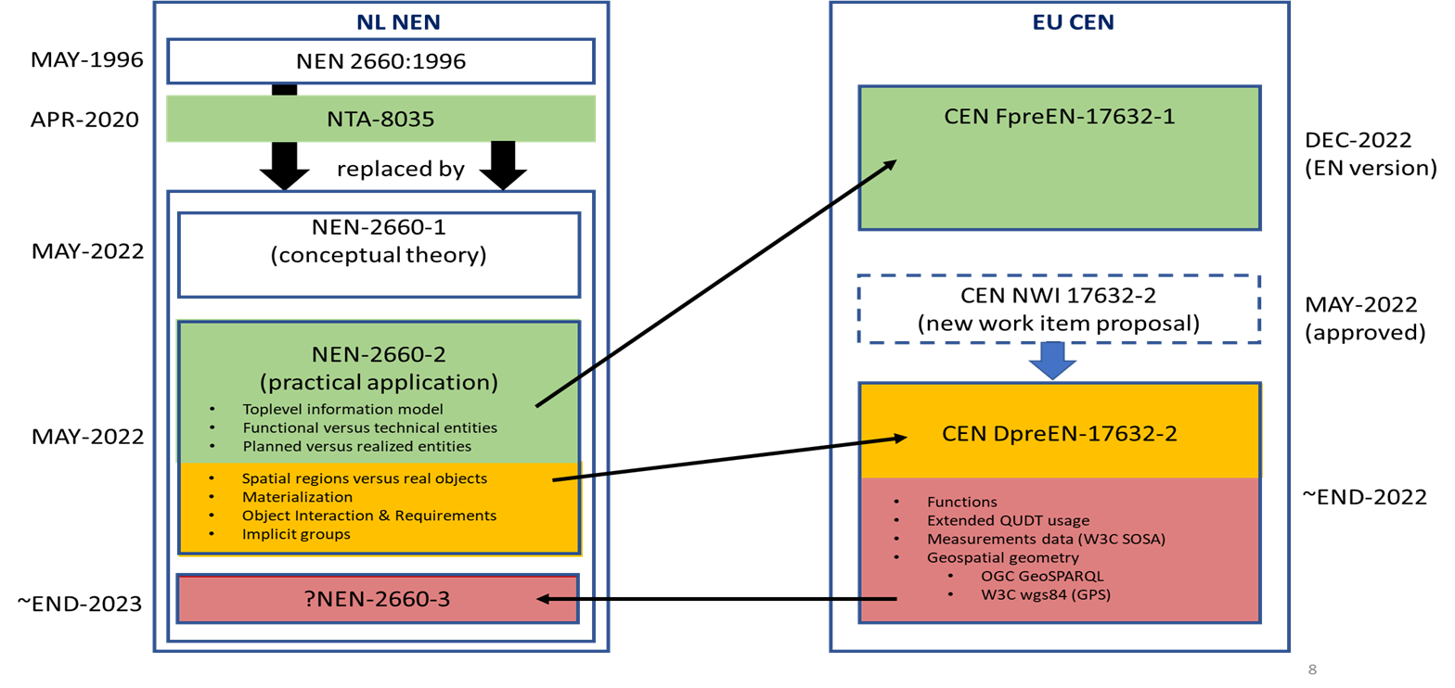
Process, status & steps
In final editing phase now.

Slide 28

Thank you for
Your time

